Slide 2
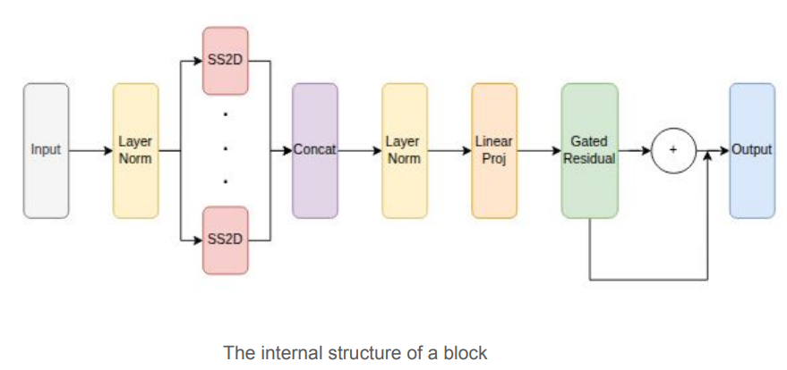
Methodology
Layer Normalization
  Normalize input features → Stabilizes distribution, improves learning.
Multi-Head Split & SS2D Modules
  Split into heads → Each head uses SS2D to learn unique spatial patterns (like attention heads, but linear-time).
Concatenation & Fusion
  Concatenate head outputs → Apply layer norm + linear projection to merge contextual info.
Gated Residual Module
  Use learnable gate (γ) → Adds enhanced features back to input, preserving stability and details.
Overall Block: Capture local + global context efficiently
Notes:
Slide Title: Visual State-Space (VSS) Block
“Let’s take a closer look at the VSS block, the core building unit of our VSSM-UNet architecture. At a high level, a VSS block replaces the usual convolution or attention layers with efficient state‐space operations to capture both local and global context. Here’s how it works step by step:
Layer Normalization
First, we normalize the input feature map to stabilize its distribution. This helps the block learn more reliably.
Multi-Head Split & SS2D Modules
We split the normalized features into several “heads.” Each head is processed independently by a Selective State-Space 2D (SS2D) module. You can think of each SS2D as learning its own spatial pattern—like multiple attention heads in a Transformer, but with linear time complexity.
Concatenation & Fusion
Next, we concatenate all head outputs along the channel axis to form a rich contextual feature map. We apply another layer normalization, followed by a small linear projection that fuses information across heads.
Gated Residual Module
To control how much of the new, attention‐enhanced features to add back, we use a learnable gate parameter, γ. This gated residual connection adds the transformed features back to the original input, reinforcing important details while preserving stability.
The result is a block that can reason over multiple spatial scales and directions, yet runs in linear time with respect to image size. This design gives VSSM-UNet both the precision of convolutional layers and the global context power of self-attention—without the heavy computational cost.”

Slide 3
Loss Function
In the initial version of the model, the training loss function used was BceDiceLoss, which is a weighted combination of Binary Cross-Entropy (BCE) Loss and Dice Loss.
In the modified version, we replaced this with a custom designed AdvancedLoss function, which integrates four distinct loss components:
  BCEWithLogitLoss: Pixel vised classification accuracy
  Tversky Loss: Handles class imbalance and controls error types
  Focal Tversky Loss: Puts more weight on hard examples
  Log-Cosh Dice Loss: To make the learning process more stable and less sensitive to outliers
Notes:
Let’s now move on to our loss function improvements. In the original setup, AdvancedLoss is designed to make the segmentation model more robust and accurate under challenging conditions.
Why Move Away from BceDiceLoss?
Originally, BceDiceLoss is used, which balances pixel-wise accuracy with mask overlap. While effective, it can fall short when classes are highly imbalanced or lesion boundaries are complex.
What Is AdvancedLoss?
AdvancedLoss combines four complementary components:
BCEWithLogitsLoss – Provides numerically stable, pixel-level classification accuracy.
Tversky Loss – Explicitly balances penalties for false positives and false negatives to handle class imbalance.
Focal Tversky Loss – Applies an exponent (γ) to focus learning on the hardest, most ambiguous pixels.
Log-Cosh Dice Loss – Smooths the Dice loss surface for steadier training and reduced sensitivity to outliers.
How Does It Help?
By weighting and summing these terms—each targeting a different type of error—our model learns richer, more generalizable features:
Class imbalance? Tversky Loss adapts the penalty.
Hard boundaries? Focal Tversky focuses on difficult pixels.
Training stability? Log-Cosh Dice dampens sudden loss spikes.
Bottom Line
AdvancedLoss gives our model the flexibility to optimize for local accuracy, global overlap, and challenging cases simultaneously—delivering stronger, more reliable segmentation performance, even on small or irregular lesions.

